Slide 1
SUDOKU SOLVER
Submitted By:
S.M. Iqbal Morshed
Roll-39.
Helal Uddin Hejazi
Roll-44.

Slide 2
Rules For Solving A Sudoku
For a given Sudoku -
2 | 3 |  |  | 6 | 9 |  |  | 5
1 |  |  |  |  | 2 | 6 | 7
 |  |  |  |  |  | 9 |  | 2
8 | 7 |  |  | 2 | 4 |  | 5
6 |  | 3 |  |  |  | 2 |  | 1
 | 9 |  | 3 | 1 |  |  | 6 | 8
3 |  | 4
 | 1 | 8 | 2 |  |  |  |  | 4
7 |  |  | 1 | 4 |  |  | 9 | 6
We have to fill up the blank boxes with
Digits (1-9) such that -
1. No row contains the same digit
more than one .
2. No coloumn contains the same
digit more than one.
3. No region (i.e. 3*3 box) contains the same digit more than one.

Slide 3
Algorithm Used In Sudoku Solver
The algorithm used in Sudoku Solver is to fill a specific blank box with appropriate number from 1 to 9 .
It will check from 1 to 9 ,to see which number is valid for that box .
If any of the number is valid, it will store that number in that box and then proceed for the next blank box
If any number from 1to 9 is not valid for that box, it will go back to the previous position and check from the next value of that number

Slide 4
Algorithm
2 | 3 |  |  | 6 | 9 |  |  | 5
1 |  |  |  |  | 2 | 6 | 7
 |  |  |  |  |  | 9 |  | 2
8 | 7 |  |  | 2 | 4 |  | 5
6 |  | 3 |  |  |  | 2 |  | 1
 | 9 |  | 3 | 1 |  |  | 6 | 8
3 |  | 4
 | 1 | 8 | 2 |  |  |  |  | 4
7 |  |  | 1 | 4 |  |  | 9 | 6
7
4
1
8
4
5
8
3
9
No digit(1-9)
Is available
In this way we can
SOLVE the
SUDOKU
Completely.

Slide 5
Our Sudoku Solver
We have developed our Sudoku Solver such that it solves the Sudoku , based on that algorithm within one second.
We can provide input from Keyboard.
Or we can provide input from file.

Slide 6
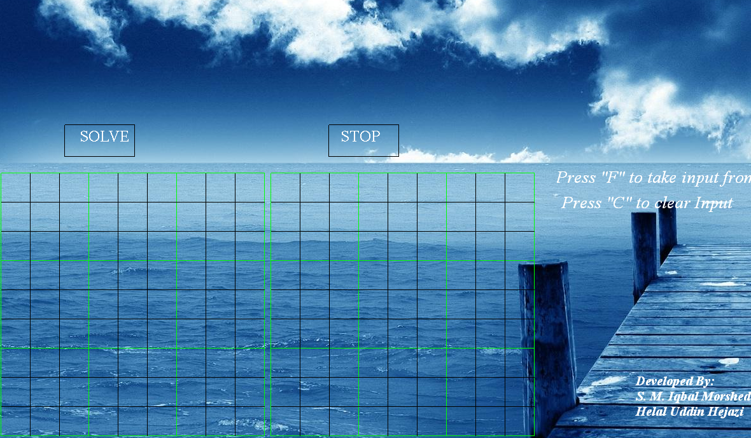
Graphical Interface
After providing input
Press the “SOLVE”
Button to see output
Press “STOP”
Button if you don’t
Want to see output
The Input box
The output box
Press “F” to take
Input from file
Press “C” to clear
The input

Slide 7
Header Files Used
For graphical works we used
Other header files used are
1. <stdlib.h>
2. <string.h>
“Igraphics.h”

Slide 8
Advantages & Disadvantages
Advantages
    We can solve any Sudoku quickly & easily.
Disadvantages
    Sometimes it is boring to provide 81 inputs

Slide 9
Future Plan
Our future plan is to make it a complete game, problems will be provided and user have to solve it .
There will be different levels of difficulty.

Slide 10
Thanks to all

